Slide 1


Training Calendar
2024
There Has To Be A Better Way For
Technical Capacity Building.
Mitiget© Delivers Simple Solution To Complex Problems.
Mitiget Learning Academy (MLA)
Info@Mitiget.com | www.Mitiget.com
Front Wing, 5th Floor, Oluwatobi House
73 Allen Avenue, Ikeja, Lagos Nigeria
+234 806 719 1062, +234 706 648 5519

Slide 2

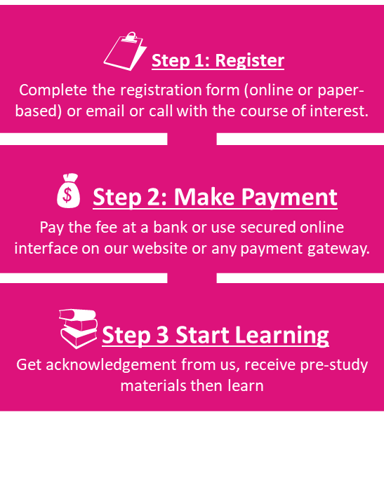
Mitiget Learning Academy (MLA)
Training Calendar 2024
About Us
Mitiget Learning Academy (MLA) is a member of Mitiget Group that provides cutting edge learning interventions and capacity building endeavours for individuals, small, medium and large-scale enterprises both in public and private sectors in Nigeria and beyond. We provide targeted contents that impact learner’s culture in order to stimulate performance in your organization. Our exceptional approach to learning is innovative, convenient and tailored to help organizations achieve strategic goals. We deliver learning using multi-channels alongside support mechanisms involving our team of experienced trainers and counsellors.
What We Do
Cancellation and Refund Policy
Instructor-led Training
Hand-on, impactful and fun training by a certified instructor.
E-Learning Training
Anytime, anywhere training for flexibility and impact.
In-House Learning Program
Design of organization specific learning program/platform.
Knowledge Management
Technology implementation and change training.
Training Delivery Mode and Enrolment Process
Online or in-class; national or international; based on scheduled/open course or customized.
1-On-1 | Group | Flexible Date | Flexible Location
Cancellation and Refund Policy
Payment for a course is regarded as confirmation to attend and the candidate/sponsor agrees to MLA's payment policy. MLA reserves the right to postpone or cancel a course due to unforeseen circumstances. In such cases, delegates will be registered for the next run of the course. The following applies to late cancellations:
Cancellation Note | Charge
At least 14 days to course date | 10% of course fee
Less than 14 days to course date | No refund – use fund for another training
The course fee covers tuition, and course materials and are inclusive of VAT. Bookings are confirmed only with the payment of the fee. Our bank details are:
Account Name:
Mitiget Assurance & Tech. Services Limited
Zenith Bank Accounts: NAIRA - 1015340385
USD ($) – 5071187539 POUNDS (£) - 5060300653
We offer discounts on our trainings as follows:
  1. Early bird (register and pay at least 1 month ahead of the course date) enjoys 5% discount.
  2. Group (minimum of 5 nominees for a course) attracts 5% discount.
For further information, please see the contacts on the cover of the leaflet. You may send us an email using info@mitiget.com

Slide 3

Mitiget Learning Academy (MLA)
Training Calendar 2024
Mitiget Learning Academy (MLA)
Training Calendar 2024
2024 Certificate Course Outlay
Code | Course Title | Duration
P4001 | ISO/IEC 27001 Information Security - Lead Implementer or Auditor | 5 Days
P4003 | ISO/IEC 27005 Information Security Risk Management - Risk Manager | 5 Days
P4005 | ISO/IEC 27032 Lead Cybersecurity Manager | 5 Days
P4006 | ISO/IEC 27035 Lead Incident Manager | 5 Days
P4007 | Human Resources Security Foundation | 5 Days
P4008 | Lead Pen Test Professional | 5 Days
P4010 | ISO 22301 Business Continuity Management System Lead Implementer or Auditor | 5 Days
P4013 | Disaster Recovery Manager | 3 Days
P4015 | ISO 22316 Lead Resilience Manager: Organizational Resilience | 5 Days
P4016 | ISO 22320 Lead Emergency Manager: Emergency Management | 5 Days
P4017 | ISO 31000 Risk Management - Risk Manager or Lead Risk Manager | 5 Days
P4020 | ISO 37001 Anti-Bribery - Lead Implementer or Auditor | 5 Days
P4022 | ISO 19600 Lead Compliance Manager | 5 Days
P4023 | ISO/IEC 38500 IT Corporate Governance Manager | 5 Days
P4024 | ISO/IEC 38500 Lead IT Corporate Governance Manager | 5 Days
P4025 | ISO/IEC 27701: Privacy Information Management System (PIMS) - LI or LA | 5 Days
P4027 | GDPR - Certified Data Protection Officer | 5 Days
P4028 | ISO/IEC 29100 Lead Privacy Implementer | 5 Days
P4029 | Lead Digitalization and Electronic Archiving Manager | 5 Days
P4030 | Cyber Threat Assessment & Reporting Training | 5 Days
P4031 | Chief Information Security Officer | 5 Days
P4032 | ISO 37301 - Compliance Management System (CMS) Lead Implementer | 5 Days
P4033 | Lead Cloud Security Manager | 5 Days
P4034 | ISO 45001 Occupational Health and Safety Management System | 5 Days
P4035 | Lead Ethical Hacker | 5 Days
P4036 | Cybersecurity Maturity Model - Certified Professional | 5 Days
P4037 | Digital Transformation Officer | 5 Days
P4038 | ISO/IEC 38500 IT Corporate Governance Manager | 5 Days
MLA collaborates with PECB, an international certification body, to provide education, certification, and certificate programs for individuals on a wide range of disciplines across Africa. Apart from the quality training, we jointly help professionals demonstrate their competence in various areas of expertise by providing valuable evaluation, certiﬁcation, and certificate programs against internationally recognized standards. Contact us today to hone your skills and get ahead in your career or for your team.
Training Mode & Cost
Virtual Instructor-led
On-Site Instructor-Led
Note: Payment could be in Naira at the prevailing market price. Reach out to discuss the suitable rate. Booking is all year.
Booking and Paymet
Contact us to book for your PECB courses. Bookings are confirmed only with the payments in favour of:
Mitiget Assurance & Technology Services Ltd
Zenith Bank Accounts: NAIRA - 1015340385
USD ($) – 5071187539 POUNDS (£): 5060300653
2. Discounts are available for group bookings.

Slide 4
Mitiget Learning Academy (MLA)
Training Calendar 2024
Mitiget Learning Academy (MLA)
Training Calendar 2024
Certification Training Courses
Code | Course Title | Duration
P4001 | ISO/IEC 27001 Information Security - Lead Implementer or Auditor | 5 Days
P4003 | ISO/IEC 27005 Information Security Risk Management - Risk Manager | 5 Days
P4005 | ISO/IEC 27032 Lead Cybersecurity Manager | 5 Days
P4006 | ISO/IEC 27035 Lead Incident Manager | 5 Days
P4007 | Human Resources Security Foundation | 5 Days
P4008 | Lead Pen Test Professional | 5 Days
P4010 | ISO 22301 Business Continuity Management System Lead Implementer or Auditor | 5 Days
P4013 | Disaster Recovery Manager | 3 Days
P4015 | ISO 22316 Lead Resilience Manager: Organizational Resilience | 5 Days
P4016 | ISO 22320 Lead Emergency Manager: Emergency Management | 5 Days
P4017 | ISO 31000 Risk Management - Risk Manager or Lead Risk Manager | 5 Days
P4020 | ISO 37001 Anti-Bribery - Lead Implementer or Auditor | 5 Days
P4022 | ISO 19600 Lead Compliance Manager | 5 Days
P4023 | ISO/IEC 38500 IT Corporate Governance Manager | 5 Days
P4024 | ISO/IEC 38500 Lead IT Corporate Governance Manager | 5 Days
P4025 | ISO/IEC 27701: Privacy Information Management System (PIMS) - LI or LA | 5 Days
P4027 | GDPR - Certified Data Protection Officer | 5 Days
P4028 | ISO/IEC 29100 Lead Privacy Implementer | 5 Days
P4029 | Lead Digitalization and Electronic Archiving Manager | 5 Days
P4030 | Cyber Threat Assessment & Reporting Training | 5 Days
P4031 | Chief Information Security Officer | 5 Days
P4032 | ISO 37301 - Compliance Management System (CMS) Lead Implementer | 5 Days
P4033 | Lead Cloud Security Manager | 5 Days
P4034 | ISO 45001 Occupational Health and Safety Management System | 5 Days
P4035 | Lead Ethical Hacker | 5 Days
P4036 | Cybersecurity Maturity Model - Certified Professional | 5 Days
P4037 | Digital Transformation Officer | 5 Days
P4038 | ISO/IEC 38500 IT Corporate Governance Manager | 5 Days
MLA collaborates with PECB, an international certification body, to provide education, certification, and certificate programs for individuals on a wide range of disciplines across Africa. Apart from the quality training, we jointly help professionals demonstrate their competence in various areas of expertise by providing valuable evaluation, certiﬁcation, and certificate programs against internationally recognized standards. Contact us today to hone your skills and get ahead in your career or for your team.
Training Mode & Cost
Virtual Instructor-led
On-Site Instructor-Led
Note: Payment could be in Naira at the prevailing market price. Reach out to discuss the suitable rate. Booking is all year.
Booking and Paymet
Contact us to book for your PECB courses. Bookings are confirmed only with the payments in favour of:
Mitiget Assurance & Technology Services Ltd
Zenith Bank Accounts: NAIRA - 1015340385
USD ($) – 5071187539 POUNDS (£): 5060300653
2. Discounts are available for group bookings.

Slide 5

Mitiget Learning Academy (MLA)
Training Calendar 2024
Mitiget Learning Academy (MLA)
Training Calendar 2024
Off-shore Certificate and Certification Training Courses
Training Mode & Cost
Virtual Instructor-led
On-Site Instructor-Led
Note: Payment could be in Naira at the prevailing market price. Reach out to discuss the suitable rate. Booking is all year.
Booking and Payment
Contact us to book for your courses. Bookings are confirmed only with the payments in favour of:
Mitiget Assurance & Technology Services Ltd
Zenith Bank Accounts: NAIRA - 1015340385
USD ($) – 5071187539 POUNDS (£): 5060300653
2. Discounts are available for group bookings.

